Slide 1



Interprofessional Education and Collaborative Practice: The what, when, and how
Jaclyn Schwieterman, EdD, ATC
Anthony Breitbach, PhD, ATC , FASAHP, FNAP
Sarah Manspeaker, PhD, ATC, FNAP
Notes:
Jaclyn

Slide 2


Disclosures
No conflict​s to disclose
The views expressed in these slides and today’s discussion are ours
  Our views may not be the same as the views of our company’s clients or colleagues​
Participants must use discretion when using the information contained in this presentation
Notes:
Jaclyn

Slide 3
Objectives
Differentiate between interprofessional education (IPE) and clinical practice (IPCP)
Identify strategies to incorporate IPECP into clinical practice
Develop approaches to include students in IPECP during clinical education experiences
Notes:
Jaclyn

Slide 4


Road Map
Background & historical info about IPECP
What is, and is not, classified as IPECP
Strategies athletic trainers can use to incorporate IPCP into practice
Notes:
Jaclyn

Slide 5


What?
Notes:
Jaclyn

Slide 6

Interprofessional
Collaborative Practice
Interprofessional
Education
Health workers from different
professions work together
Students learn with, from,
and about each other
Notes:
Jaclyn

Slide 7
What is IPE?
IPE = Interprofessional Education
  As defined by the World Health Organization (WHO) “Interprofessional education occurs when students from two or more professions learn about, from and with each other to enable effective collaboration and improve health outcomes” (WHO, 2010).
  (WHO, 2010, IPEC, 2016)
Notes:
Jaclyn
IPE is the foundation to be able to collaborate in the clinical setting.
There is evidence that IPE has a positive effect on:
Understanding of the roles and responsibilities of other professional groups
Learners’ attitudes towards one another’s professions
Knowledge of the nature of interprofessional collaboration
Actual collaborative behavior
Organizational practice (referral practices, documentation)
Delivery of care (patient satisfaction, length of stay)
Clinical outcomes (clinical error rates, infection rates)
IPEC – formed to promotes, encourages, and supports academic institution’s efforts to prepare future health care professionals to work collaboratively

Slide 8
What is IPCP?
IPCP= Interprofessional Collaboration Practice
  As defined by the World Health Organization (WHO) Interprofessional Collaborative Practice is when “multiple health workers from different professional backgrounds provide comprehensive services by working with patients, their families, careers and communities to deliver the highest quality of care across settings.”
(WHO, 2010)
Notes:
Jaclyn
Collaborative practice can improve:
• access to and coordination of health-services
• appropriate use of specialist clinical resources
• health outcomes for people with chronic diseases
• patient care and safety
Collaborative practice can decrease:
• total patient complications
• length of hospital stay
• tension and conflict among caregivers
• staff turnover
• hospital admissions
• clinical error rates
• mortality rates

Slide 9
Misconceptions
Notes:
Jaclyn
A lot of health care professionals will say they do partake in IPE/IPCP, but their idea or thoughts may not actually be IPE/IPCP. Here are a few examples of what IPE/IPCP is not
Referrals
Working in the same area
Lectures from other health care professionals
Working in the same room/ learning in the same room
Understanding of other health professional’s roles
Having casual conversations with other health care professionals

Slide 10
Examples of IPE/IPCP
Case studies (Kent, Courtney, & Thorpe, 2018)
Patient interviews by student teams (Kent, Courtney, & Thorpe, 2018)
Interprofessional wards (Mink et al., 2019)
Notes:
Jaclyn

Slide 11

Notes:
Jaclyn
Development/Education
Didactic
Grand Rounds
Clinical education is vital (Mazerolle et al., 2016)
An important aspect of educating health care students including athletic training is experiential learning through clinical education.
Literature describes the clinical setting is where athletic training students are socialized to the profession. This is a great place to provide collaborative experiences with preceptors role modeling what is meant by team-based care. In order to develop collaborative Athletic trainers, students should experience this in the clinical setting.
Preceptor development for athletic training programs in Interprofessional Education (IPE) and Interprofessional Collaborative Practice (IPCP) is needed

Slide 12

When?
Notes:
Jaclyn—transition to Tony at this point

Slide 13
United States Health Care System
Cost to performance ratio (Schneider, Sarnak, Squires, Shah, & Doty, 2017)
3rd Leading cause of death (Martin & Michael, 2016)
Communication failure & Poor teamwork (Mazzocco et al., 2009; Wilson et al., 1995)
Notes:
Tony
Cost to performance ratio on health care is not equal (Schneider, Sarnak, Squires, Shah, & Doty, 2017)
Out of 11 countries, the U.S. is positioned last in the health care system performance rankings c
Medical Errors 3rd leading cause of death (Martin & Michael, 2016
Communication failure and poor teamwork (Mazzocco et al., 2009; Wilson et al., 1995)

Slide 14
Historical perspectives
1972
Educating for the Health Team (Institute of Medicine, 1972)
1980s
2007
2010
2011
IHI develops Triple Aim (Berwick, Nolan, & Whittington, 2008
WHO promotes collaboration to help patients, decrease tension between professionals (Fransworth, Seikel, Hudock, & Holst, 2015)
WHO define IPE and IPCP (WHO, 2010)
IPEC core competencies developed (IPEC, 2016)
Patient Protection and Affordable Care Act Passed in United States
Quadruple aim developed from Triple Aim
2017
2022
Quintuple Aim developed
1972
2007
2011
2022
1980s
2010
2017
Notes:
Tony
IPE was first introduced during an Institute of Medicine conference on interrelationships of educational programs for health professionals in 1972. From this conference a report was developed titled “Educating for the Health Team”. This report outlined the issues that are important to interdisciplinary education. Recommendations were made a the administrative, teaching and national level
In the late 1980’s the World Health Organization began programs that promoted collaboration to meet the needs of patients and decrease tension between professionals.
In 2010 – The World Health Organization defines IPE stating that IPE occurs when students from 2 or more professions learn about, from and with each other to enable effective collaboration and improve health outcomes
Also in 2010 Patient Protection and Affordable Care Act was passed in the United States
Interprofessional Education Collaborative was influential in developing a framework for IPE in the United States
In 2011 – IPEC developed core competencies listed here
2016 updated standards for IPE to the triple aim listed here
2017 Triple aim was modified to the quadruple aim which added in provider work life (Don't spend a lot of time on quintuple aim here, will appear later as a resource)

Slide 15
AT Historical Perspective
2012
IPE/IPCP discussed in Future of AT Education Document (Breitbach et al., 2018)
2013
2014
2015
2018
CAATE standards revised to include IPE at master’s level (Executive Committee for Education, 2012)
White Paper Developed (Breitbach et al., 2015)
Athletic trainers have a place in Interprofessional Education & Practice (Rizzo, Breitbach, Richardson, 2015)
CAATE standards edited to include IPE/IPCP in the 2020 Standards for Professional Programs (CAATE, 2018)
2020
July 2020, new CAATE standards are in effect (CAATE, 2018)
2012
2014
2018
2013
2015
2020
July 2020, new CAATE standards in effect (CAATE, 2018)
Notes:
Tony
Here you can see when and how athletic training has been involved with IPE/IPCP.
2012 – started to talk about it in the Future directions of AT education document
To 2018 when IPE/IPCP was included in 2 of the 2020 standards for professional programs which aligns with the degree transition for athletic training

Slide 16

How?
Notes:
Tony transition to Sarah

Slide 17
How?
Identify resources
Identify areas for collaboration
Establish clinical education opportunities
Connect resources to curricular content
Notes:
Sarah

Slide 18
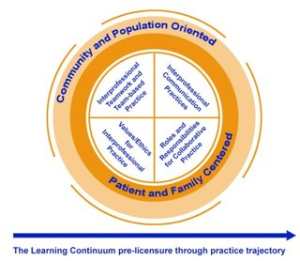
Core Competencies
Interprofessional Education Collaborative: https://www.ipecollaborative.org/

Slide 19

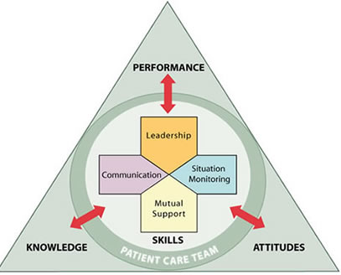


Healthcare IPCP
https://www.ihi.org/resources/Pages/Publications/quintuple-aim-for-health-care-improvement.aspx
https://www.ahrq.gov/teamstepps/index.html

Slide 20
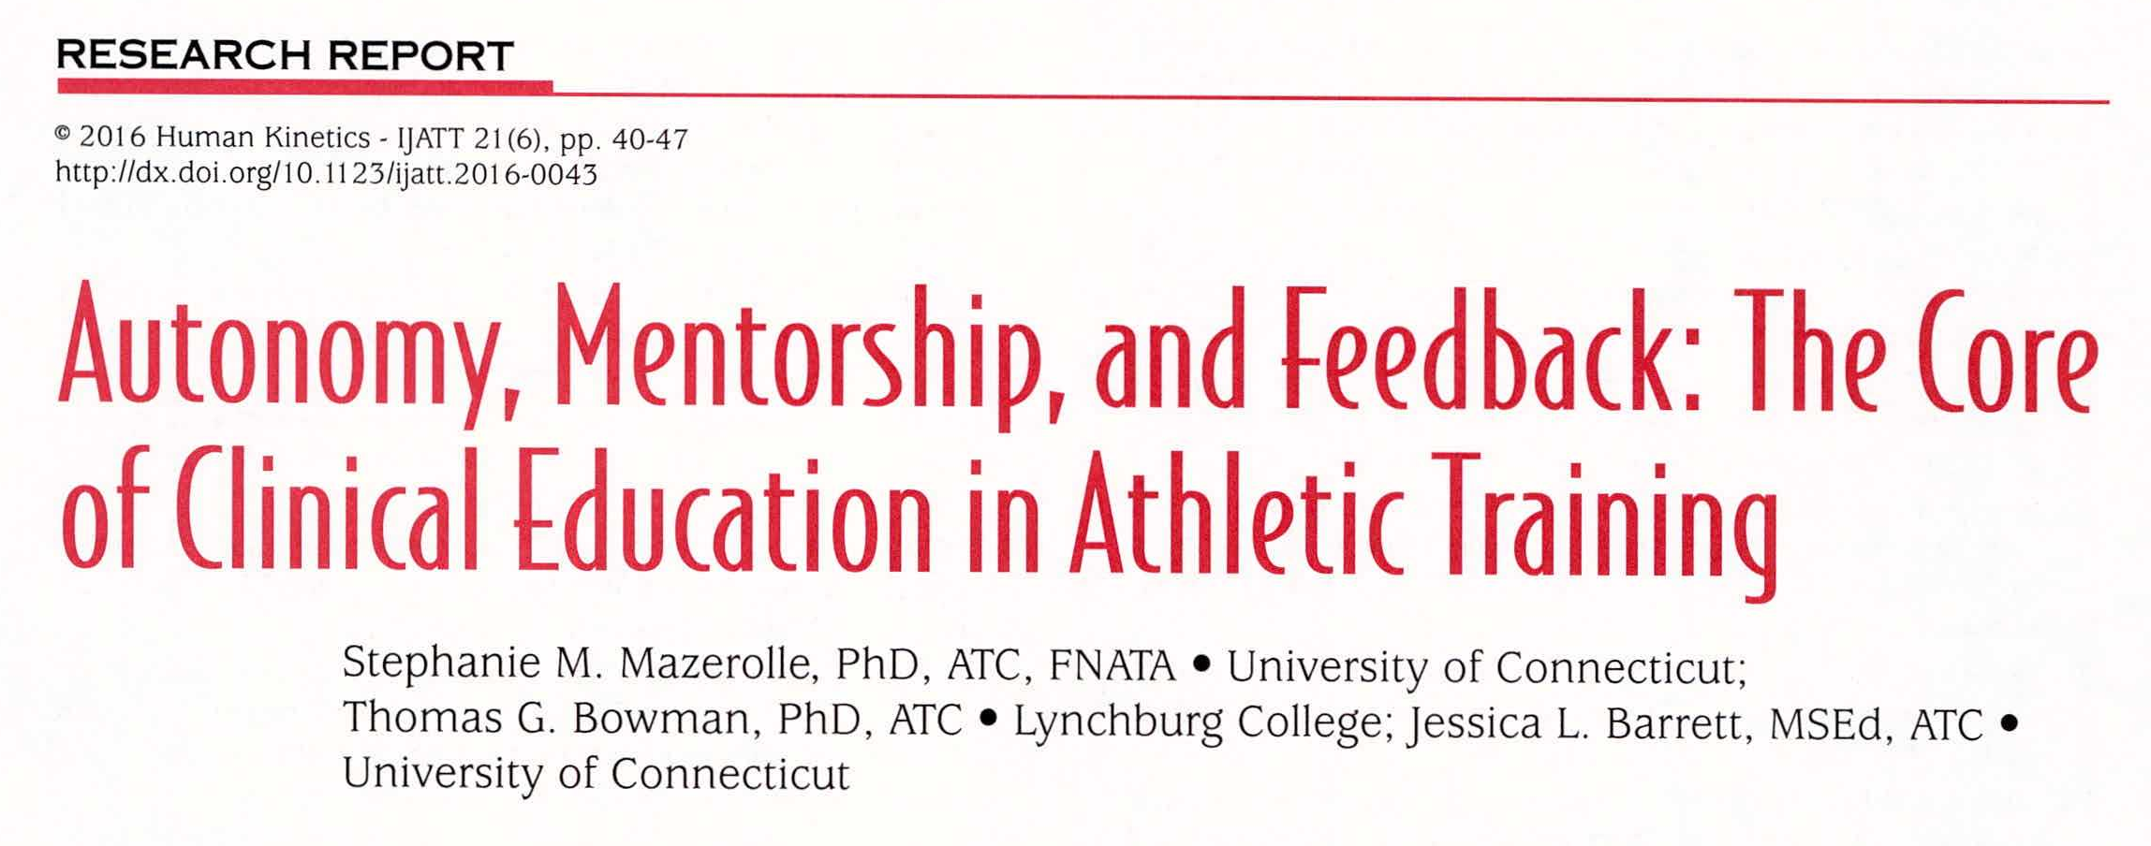
Clinical Education
Notes:
Sarah
Purpose - Socializing students to the profession
Currently being done
Study by Walker shows IPCP during clinical education is low
Current IPCP development
Encounters recorded
3.9% with another health care provider
3.6% w/ another health
Preceptor development
Teacher/mentor
Knowing student abilities and limitations
Learning other professions scope of practice

Slide 21
Planned IPE is incorporated within the professional program
Standard 61 - Practice in collaboration with other health care and wellness professionals
Other standards
(CAATE, 2018)
Notes:
Sarah
As most of you know, the Athletic training degree is transition from a bachelors to a masters. With this transition, the Commission for Accreditation for Athletic Training Education has updated the standards for programs which includes IPE/IPCP in standards 8 and 61. Although these standards have the IPE specific language in them, other standards may be able to be met with IPE/IPCP experiences such as assessment techniques.
The IPEC competencies mentioned before compliment these standards

Slide 22
Core Competency | Progression | Sub-competencies
Communication | Basic | CC4 – Listen actively, and encourage ideas and opinions of other team members
 | Intermediate | CC5 – Give timely, sensitive, instructive feedback to others about their performance on the team, responding respectfully as a team member to feedback from others
 | Advanced | CC3 – Express one’s knowledge and opinions to team members involved in patient care and population health improvement with confidence, clarity, and respect, working to ensure common understanding of information, treatment, care decisions, and population health program and policies
(Gunaldo, Brisolara, Davis, & Moore, 2017 )
Notes:
Sarah
On this slide is the core competency communication. At the basic level, students should be able to listen actively, and encourage ideas and opinions of other team members. As students get to their final clinical experience, they should be able to express one’s knowledge and opinions to team members involved in patient care and population health improvement with confidence, clarity, and respect, working to ensure common understanding of information, treatment, care decisions, and population health program and policies

Slide 23
How can you facilitate IPCP as a preceptor, educator, or clinician?
Carrying over what is learned in the classroom to the clinical setting
Use IPEC sub-competencies progression above as guidance
Identify opportunities to team in the clinical space
Share experiences of IPE/IPC
Involve students in the full care of patient
Notes:
Sarah
As the preceptor you are in the forefront of the clinical educational experience and a mentor /role model for the students. There are several ways that you can incorporate IPE/IPCP into the clinical experience to ensure that students are achieving those sub competencies and progressing through their clinical experience.
First carrying over what is learned in the classroom with IPE/IPCP. This is definitions to expectations
The sub competencies listed on the previous slides can also be helpful in setting goals with students for the clinical experience.
Identify opportunities that you can give the student that involves IPE/IPCP. Is there an opportunity to work with other health care professionals on patient case or discussing a treatment plan. Are there other students in different health professions present that could work together with patient care
Talk about what you have done and how you have been involved with IPE/IPCP experiences. You may not have called them this before but this is important to discuss how the return to play of an athlete took a full interprofessional team working together
Involving students in the full care of the athletes – there are times that we do things prior to the students arriving so that we have full attention to supervise them or review things that they are going over in class. Are there tasks that you could delegate or complete with the student that involves a patient and working with another health care provider?

Slide 24
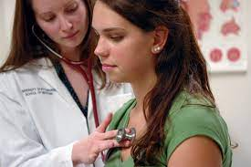
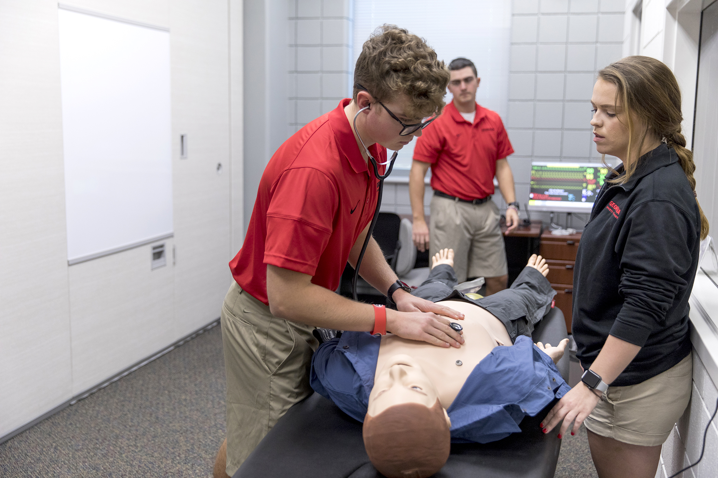


Classroom Setting
Notes:
Sarah
Didactic setting we can include
Standardized patient cases with various professions involved or transfers
Simulations
Grand Rounds
Case Studies

Slide 25
Clinical Setting
Notes:
Sarah
Opportunities are going to vary by setting. Some settings will have access to any health professional that you can think of, others may be in a rural area with very limited access to other health care professionals. Capitalize on what you have. In the high school, working with the school nurse, counselor or team physician. It’s ok if some conversations are via phone or email.
What does your setting have?
Who are the health care professionals you work with?
Reach laterally, get in habit of reaching out
Examples
Secondary School – Physician, school nurse, school counselor
College/University – dependent on size and resources
Professional – resources / network available
Emerging settings – engineer, EMS

Slide 26
Preceptor Tips
Set the stage
Role model
Awareness
Patient-centered care
Rotate presenting patient
Reflection
Evaluation
(Shrader & Zaudke, 2018)
Notes:
Jaclyn
Facilitating IPE/IPCP in the clinical setting can be challenging. Here are a few tips as you interact with students and help to facilitate IPE/IPCP experiences
Set the stage – be sure that students know it is a safe space – allow questions, get to know the learner
Role model- verbalize and communicate what you are doing, think before you speak/act
Awareness- be aware of hierarchy, culture and stereotypes that may be in your workplace or in others that you work with
Patient centered – team based care is still all about the patient, be sure the patient is still the focus point
Rotate Presenting Patient – if more than one student, rotate who presents the case to you
Reflection – be explicit about the IPC experience
Evaluation – with the student evaluate hoe the team did as well as the individual in the situation

Slide 27
Take away Points
Using the same Language
Athletic Training Standards emphasize importance of IPE/IPCP
Progression of learning
Preceptors are vital for students learning IPE/IPCP
Notes:
Jaclyn
Here are some final take away points to remember.
1 Be sure to define IPE/IPCP the same
2. Use the progression of learning to help develop students as interprofessional team members
3. The new standards for athletic training programs emphasize the importance of IPE/IPCP
4. Preceptors are vital for student learning and allowing students to experience IPE/IPCP in the clinical setting

Slide 28

Notes:
Jaclyn
I like to think of Health care as an ocean, and each of us as educators, clinicians, and students are a single ripple or wave in the same body of water working together to to improve patient-centered care. clinical education is vital for students in their learning and socializing into the athletic training profession. Preceptors have an important role to serve as mentor and role model during clinical experiences and therefore are vital to facilitating collaborative practice in the clinical setting

Slide 29
References
Berwick, D.M., Nolan, T.W., Whittington, J. (2008). The triple aim: Care, health, cost. Health Affairs, 27(3), 759-769.
Breitbach, A. P., Eliot, K., Cuppett, M., Wilson, M., & Cushak, M. (2018). The progress and promise of interprofessional education in athletic training programs. Athletic Training Education Journal, 13(1), 57-66. DOI: 10.4085/130157
Breitbach, A. P., Richardson, R., Berry, D. C., Eberman, L. E., Emineth, K. K., Esparza, S. D., … Thompson, A. J. (2015). Interprofessional education and practice in athletic training. Athletic Training Education Journal, 10(2), 170–182. Retrieved from http://prx-usa.lirn.net/login?url=http://search.ebscohost.com/login.aspx?direct=true&db=s3h&AN=108927837&site=eds-live
Commission on Accreditation of Athletic Training Education. (2018). CAATE 2020 standards for accreditation of professional athletic training programs. Retrieved from https://caate.net/wp-content/uploads/2018/09/2020-Standards-for-Professional-Programs-copyedited-clean.pdf
Fransworth, T.J., Seikel, J.A., Hudock, D., & Holst, J. (2015) History and development of interprofessional education. Journal of Phonetics and Audiology 1:101. doi:10.4172/2471-9455.1000101
Gunaldo, T.P., Brisolara, K. F., Davis, A. H., & Moore, R. (2017). Aligning interprofessional education collaborative sub-competencies to a progression of learning. Journal of Interprofessional Care, 31(3), 394–396. https://doi.org/10.1080/13561820.2017.1285273
Institute of Medicine. (2001). Crossing the quality chasm: A new health system for the 21st century. Washington, DC: The National Academies Press.
Interprofessional Education Collaborative. (2016). Core competencies for interprofessional collaborative practice: 2016 update. Washington, DC: Interprofessional Education Collaborative. Retrieved from https://hsc.unm.edu/ipe/resources/ipec-2016-core-competencies.pdf
Martin A, M., & Michael, D. (2016). Medical error—the third leading cause of death in the US. BMJ, i2139. https://doi.org/10.1136/bmj.i2139
Mazerolle, S.M., Bowman, T.G., & Barrett, J.L. (2016). Autonomy, mentorship, and feedback: The core of clinical education in athletic training. International Journal of Athletic Therapy & Training, 21(6), 40-47.
Mazzocco, K., Petitti, D. B., Fong, K. T., Bonacum, D., Brookey, J., Graham, S., Lasky, R. E., Sexton, J. B., & Thomas, E. J. (2009). Surgical team behaviors and patient outcomes. The American Journal of Surgery, 197(5), 678–685. https://doi.org/10.1016/j.amjsurg.2008.03.002
Rizzo, C. S., Breitbach, A. P., & Richardson, R. (2015). Athletic trainers have a place in interprofessional education and practice. Journal of Interprofessional Care, 29(3), 256–257. https://doi.org/10.3109/13561820.2014.942778
Schneider, E. C., Sarnak, D. O., Squires, D., Shah, A. & Doty, M. (2017). Mirror, mirror: How the U.S. health care system compares internationally at a time of radical change. The Commonwealth Fund. Retrieved from https://interactives.commonwealthfund.org/2017/july/mirror-mirror/assets/Schneider_mirror_mirror_2017.pdf
Shrader, S., & Zaudke, J. (2018). Top ten best practices for interprofessional precepting. Journal of Interprofessional Education & Practice, 10, 56–60. https://doi-org.prx-usa.lirn.net/10.1016/j.xjep.2017.12.004
Walker, S. E., Cavallario, J. M., Welch Bacon, C. E., Bay, R. C., & Van Lunen, B. L. (2018). Athletic training student application of interprofessional education during clinical education: A report from the athletic training clinical education network. Athletic Training Education Journal, 13(4), 391–392. Retrieved from http://prx-usa.lirn.net/login?url=http://search.ebscohost.com/login.aspx?direct=true&db=s3h&AN=134210625&site=eds-live
Wilson, R. M., Runciman, W.B., Gibberd, R.W., Harrison, B.T., Newby, L., & Hamilton, J.D. (1995). The quality in Australian health care study. The Medical Journal of Australia, 163, 458–471.
World Health Organization. (2010). Framework for action on interprofessional education & collaboration. Retrieved from https://www.who.int/hrh/resources/framework_action/en/

Slide 30


Want to Learn More?

Slide 31
Thank you for your time!
Helpful Resources
Dropbox - IPE Articles
Mededportal – IPE Collection
Notes:
Thank you for your time.
Helpful resources
List of references can be found in dropbox

Slide 32

Questions??

